Slide 1

WEB Development
Grade 7&8

Slide 2
Recap of the last class

Slide 3

Brain Workout
Sarah wants to create a webpage where the background color of each section changes dynamically based on user interaction. If she has 4 sections and wants each section to have a different background color when a user hovers over it. how many unique background color combinations can she have for all sections?
A) 4
B) 12
C) 16
D) 24
Notes:
Answer: C) 16 Explanation: Each section has 4 unique color options, so the total combinations are 4 * 4 = 16

Slide 4

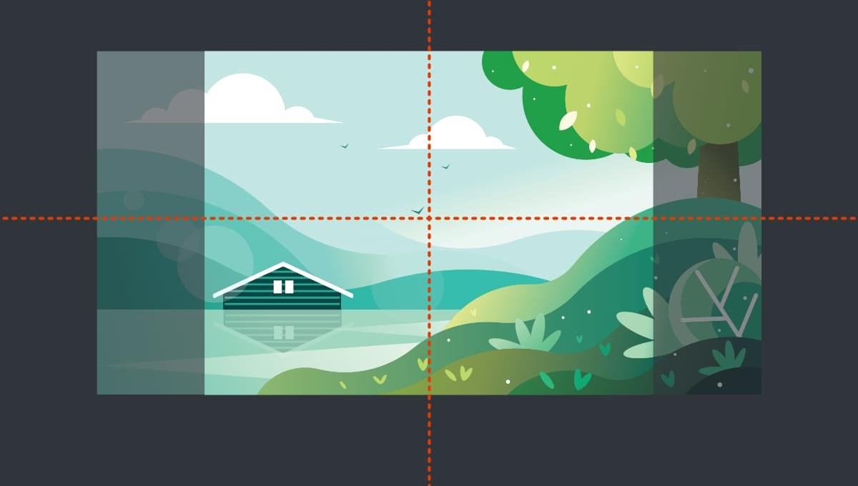
Introduction to CSS Background image
Notes:
Objective: Introduction to CSS Background Image
Teacher's Instructions:
Introduce the Topic:
Welcome the students and introduce today's lesson topic: CSS background images.
Highlight the importance of background images in enhancing web design aesthetics.

Slide 5

Sarah Wants to Stand Out
Sarah's Website was looking good, but she felt it needed something more exciting. She saw other websites with amazing background images that made them stand out.
Sarah wondered, "How can I add cool background images to my webpage?"
Determined to learn, Sarah discovered how to use CSS to add background images.
Let's help Sarah add background images to make her webpage amazing!
Notes:
Objective: Engage with Sarah's Story
Teacher's Instructions:
Engage with Sarah's Story:
Present Sarah's desire to enhance her website with background images.
Encourage students to relate to Sarah's quest for a visually appealing webpage.

Slide 6
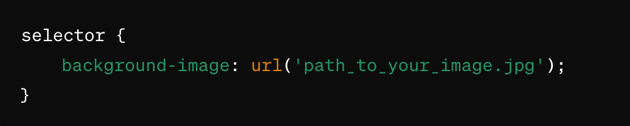
Adding Background Images with CSS
Syntax:
Background images can make your site more attractive and engaging.
Today, we'll learn how to use CSS to add background images to your web pages.
Notes:
Objective: Understanding CSS Background Images Syntax
Teacher's Instructions:
Introduce CSS Background Images:
Explain the syntax provided for adding background images using CSS.
Emphasize the role of background images in improving website aesthetics.

Slide 7
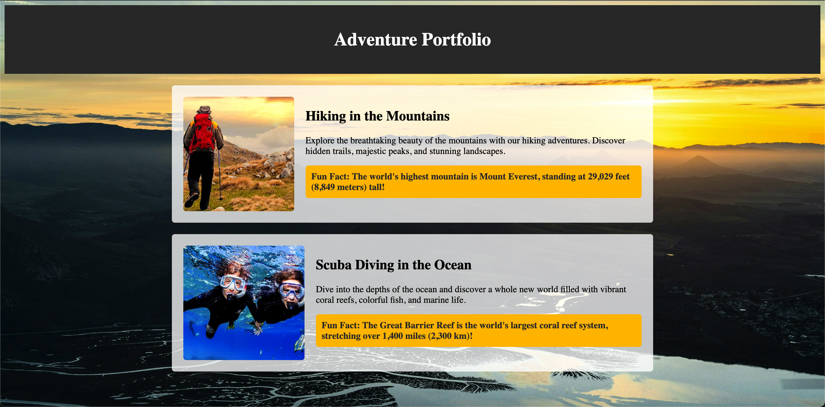
Project – Adventure Portfolio
Notes:
Project Link:
https://replit.com/@curriculumsmana/Project-Lesson-4-G-5and6#index.html
Objective: Overview of Adventure Portfolio Project
Teacher's Instructions:
Present the Project:
Display the Adventure Portfolio project screenshot.
Explain that students will create a similar webpage to apply their CSS background image skills.

Slide 8
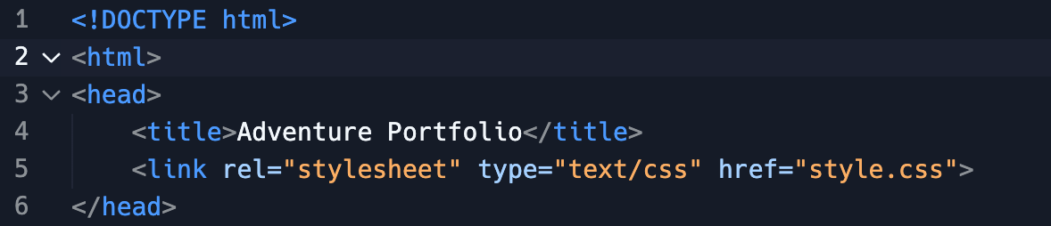
Working with the Project
HTML Code Explanation: Part-1
Notes:
"Teacher's Activity"
Objective: Explain the code to the Students (Explanation of the codes given on the next slide)
Teacher's Instructions:
Break Down the HTML Code:
Guide students through the HTML code's initial segments.
Explain the purpose of each HTML element in structuring the webpage.

Slide 9
Working with the Project
HTML Code Explanation: Part-1
<!DOCTYPE html>: This declares the document type and version of HTML.
<html>: The root element of the HTML document.
<head>: Contains meta-information about the HTML document.
<title>Adventure Portfolio</title>: Sets the title of the web page that appears in the browser tab.
<link rel="stylesheet" type="text/css" href="style.css">: Links the external CSS file for styling.
Notes:
Objective: HTML Code Explanation
Teacher's Instructions:
HTML Code Explanation:
Reinforce understanding by discussing the significance of each element.

Slide 10
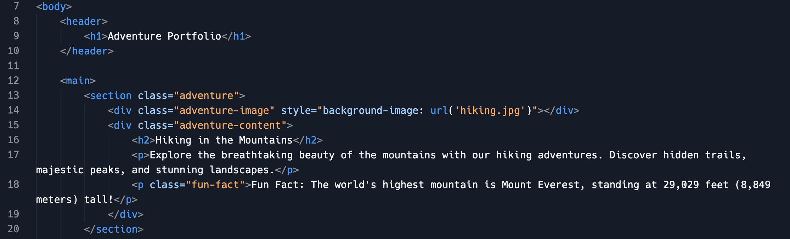
Working with the Project
HTML Code Explanation: Part-2
Notes:
Objective: Explain the code to the Students (Explanation of the codes given on the next slide)
Teacher's Instructions:
Break Down the HTML Code:
Guide students through the HTML code's initial segments.
Explain the purpose of each HTML element in structuring the webpage.

Slide 11
Working with the Project
HTML Code Explanation: Part-2
<body>: Contains the content of the web page.
<header>: Defines the header section of the page.
<h1>Adventure Portfolio</h1>: A heading for the header section.
<main>: Contains the main content of the web page.
<section class="adventure">: Defines a section of content with the class "adventure".
Notes:
Objective: HTML Code Explanation
Teacher's Instructions:
Continue HTML Code Explanation:
Proceed with dissecting the remaining HTML code segments.
Reinforce understanding by discussing the significance of each element.

Slide 12
Working with the Project
HTML Code Explanation: Part-2
<div class="adventure-image" style="background-image: url('hiking.jpg')"></div>: A div with a background image of hiking.
<div class="adventure-content">: A div containing the adventure's content.
<h2>Hiking in the Mountains</h2>: A subheading.
<p>: A paragraph describing the adventure.
<p class="fun-fact"> …...............</p>: A paragraph with a fun fact.
Notes:
Objective: Explain the code to the Students
Teacher's Instructions:
Continue explaining the HTML Code:
Guide students through the HTML code's.
Explain the purpose of each HTML element in structuring the webpage.
Note: Same we did for Another Section: follows with similar structure but for scuba diving.

Slide 13
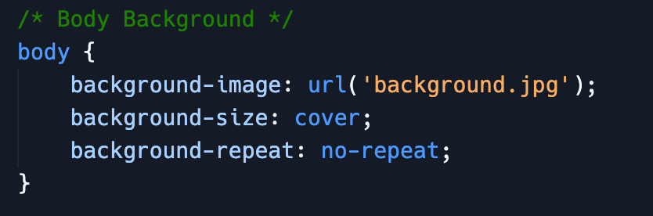
Working with the Project
CSS Code Explanation: Body Background
Sets a background image for the entire body of the page.
background-size: cover; : Makes the background image cover the entire area.
background-repeat: no-repeat; : Ensures the background image does not repeat.
Notes:
Objective: CSS Code Explanation: Body Background
Teacher's Instructions:
Explain Body Background Styling:
Clarify the CSS styles applied to the body element.
Discuss how these styles affect the overall webpage appearance.

Slide 14
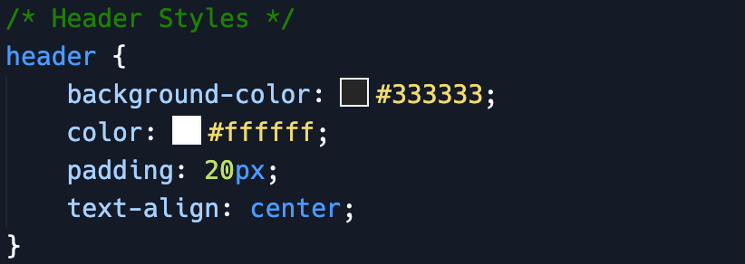
Working with the Project
CSS Code Explanation: Header Styles
background-color: #333333; : Sets the background color to dark gray.
color: #ffffff; : Sets the text color to white.
padding: 20px; : Adds padding inside the header.
text-align: center; : Centers the header text.
Notes:
Objective: CSS Code Explanation: Header Styles
Teacher's Instructions:
Discuss Header Styling:
Describe the CSS styles used to design the header section.
Illustrate how these styles impact the visual presentation of the header content.

Slide 15

Working with the Project
CSS Code Explanation: Main Content
padding: 20px; : Adds padding inside the main content area.
display: flex; : Uses Flexbox layout.
flex-direction: column; : Arranges child elements in a column.
align-items: center; : Centers the child elements horizontally.
Notes:
Objective: CSS Code Explanation: Main Content
Teacher's Instructions:
Explore Main Content Styling:
Dive into the CSS styles applied to the main content area.
Discuss how these styles enhance webpage layout and readability.

Slide 16
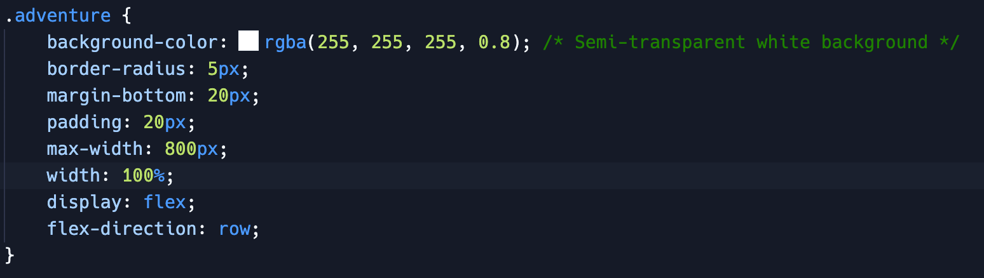
Working with the Project
CSS Code Explanation: Main Content (Adventure Section Styles)
Notes:
Objective: CSS Code Explanation: Adventure Section Styles
Note: Code explanation given on next slide.

Slide 17
Working with the Project
CSS Code Explanation: Main Content (Adventure Section Styles)
background-color: rgba(255, 255, 255, 0.8); : Sets a semi-transparent white background.
border-radius: 5px; : Rounds the corners.
margin-bottom: 20px; : Adds space below each adventure section.
padding: 20px; : Adds padding inside the section.
max-width: 800px; : Limits the width to 800px.
width: 100%; : Ensures the section takes the full width of its container.
display: flex; flex-direction: row; : Uses Flexbox to arrange child elements in a row.
Notes:
Objective: CSS Code Explanation: Adventure Section Styles
Teacher's Instructions:
Detail Adventure Section Styling:
Explain the CSS styles specific to adventure sections.
Highlight how these styles differentiate each adventure segment.

Slide 18
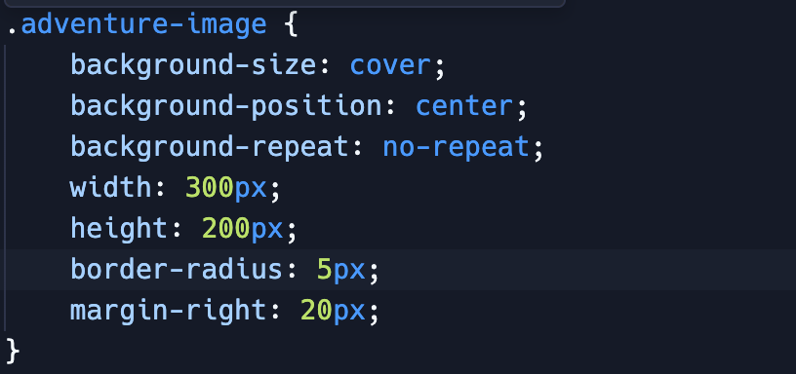
Working with the Project
CSS Code Explanation: Main Content (Adventure Image Styles)
Notes:
Objective: CSS Code Explanation: Adventure Image Styles
Note: Code Explanation given in the next slide.

Slide 19
Working with the Project
CSS Code Explanation: Main Content (Adventure Image Styles)
background-size: cover; : Ensures the image covers the entire div.
background-position: center; : Centers the image within the div.
background-repeat: no-repeat; : Prevents the image from repeating.
width: 300px; : Sets the width of the image container. height: 200px; : Sets the height of the image container.
border-radius: 5px; : Rounds the corners of the image container.
margin-right: 20px; : Adds space to the right of the image container.
Notes:
Objective: CSS Code Explanation: Adventure Image Styles
Teacher's Instructions:
Elaborate on Adventure Image Styling:
Clarify the CSS styles governing adventure image appearance.
Demonstrate how these styles contribute to webpage design cohesion.

Slide 20

Working with the Project
CSS Code Explanation: Main Content (Adventure Content Styles)
flex-grow: 1; : Makes the content area take up the remaining space.
Notes:
Objective: CSS Code Explanation: Adventure Content Styles
Teacher's Instructions:
Explain Adventure Content Styling:
Describe the CSS styles applied to adventure content sections.
Emphasize how these styles ensure proper content alignment and spacing.

Slide 21

Working with the Project
CSS Code Explanation: Main Content (Fun Fact Styles)
Notes:
Objective: CSS Code Explanation: Fun Fact Styles
Note: Code explanation given on next slide.

Slide 22
Working with the Project
CSS Code Explanation: Main Content (Fun Fact Styles)
background-color: #ffc107; : Sets the background color to a bright yellow.
border-radius: 5px; : Rounds the corners.
color: #333333; : Sets the text color to dark gray.
font-weight: bold; : Makes the text bold.
padding: 10px; : Adds padding inside the fun fact box.
Notes:
Objective: CSS Code Explanation: Fun Fact Styles
Teacher's Instructions:
Discuss Fun Fact Styling:
Delve into the CSS styles defining fun fact section appearance.
Illustrate how these styles make fun facts visually appealing.

Slide 23

Now it's your turn!
We've explored the magic of CSS background images.
Now, it's your chance to take the lead as a web designer!
Create something extraordinary:
Open your own web page and follow these fun steps.
Enhance your sections with awesome background images and make your Adventure Portfolio pop.
Show off your creativity and make it shine!
Notes:
Objective: Encouragement to Apply Knowledge
Teacher's Instructions:
Empower Students:
Encourage students to apply their newly acquired CSS background image skills to their projects.
Motivate them to unleash their creativity and design captivating webpages.
Class Activity:
Creative Web Design:
Instruct students to open their own web pages and enhance sections with background images.
Encourage them to experiment with different images and CSS properties.
Provide assistance and feedback as they work on making their Adventure Portfolio stand out.

Slide 24

How to Save & Share the project.
Replit offers autosave option – so not worry about the same.
To share project with someone in view mode: just copy the link from the URL bar, and share the link
To share the project for collaboration
Click on "Invite" from the top right corner
If you know the username, type it in the box and click on invite
You can also turn on the toggle button "private join link" to create a public collaboration link and invite members to edit your code.
Notes:
Instructions for the Teacher:
Explain how to save and share projects on Replit, including the options for collaboration.
Emphasize the importance of sharing projects for feedback and collaboration.

Slide 25


What CSS property is used to set a background image?
a) background-color
b) background-image
c) background-style
d) background-repeat
Notes:
Answer: b)

Slide 26
Which CSS property ensures the background image covers the entire element?
a) background-repeat
b) background-size
c) background-position
d) background-attachment
Notes:
Answer: b)

Slide 27
What does the background-repeat: no-repeat; property do?
a) Repeats the background image
b) Prevents the background image from repeating
c) Stretches the background image
d) Centers the background image
Notes:
Answer: b)

Slide 28
How do you make the background image appear in the center of the element?
a) background-center
b) background-align: center
c) background-position: center
d) background-middle
Notes:
Answer: c)

Slide 29

Let's Wrap it Up – What have we learnt?
Today, we learned how to use CSS to add background images.
We applied background images to both the body and specific elements.
Notes:
Instructions for the Teacher:
Summarize the key points covered in the presentation.
Reinforce the importance of practice and exploration in learning Web Devlopment.
Encourage students to continue learning and experimenting with HTML and CSS on their own.

Slide 30


Homework Discussion
Notes:
Instructions for the Teacher: Facilitate a discussion about the homework assignment.

Slide 31

Design Your Own Website Banner with CSS
Theme Selection: Choose a theme for your website banner.
Design Concept: Sketch out your banner design including background image, text placement, and colors.
Background Image: Find or create a suitable background image.
CSS Implementation: Use CSS (background-image, background-size, etc.) to design your banner on a simple HTML webpage.
Notes:
Objective: This is an extra activity for extra smart students.
Teacher's Instructions:
Guide Students in Banner Design:
Provide instructions for designing a website banner using CSS.
Encourage student to brainstorm themes and implement CSS for their banners.

Slide 32
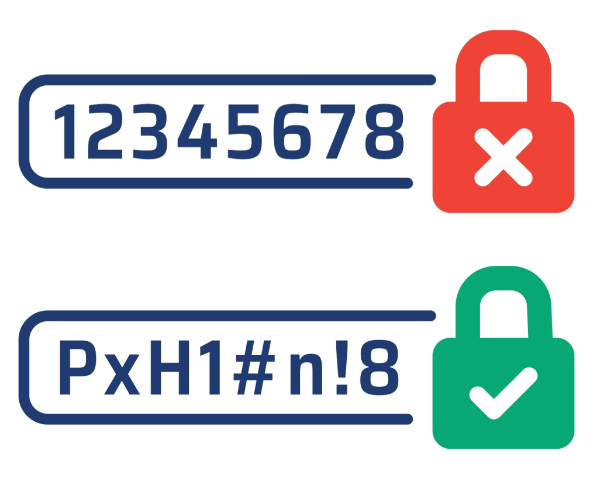
Use Strong Passwords
Create unique and strong passwords. Share passwords only with trusted adults.
Alex used a simple password, "123456," for his online games and soon found his account hacked.
After learning from his teacher, he changed it to a stronger password, "Rainbow99!," and added symbols to make it even more secure.
The moral of the story: create unique and strong passwords to keep your accounts safe and use symbols to make them stronger.

